Slide 1
AI CHATBOT USING CHATGPT
TSP- AI ML Fundamentals (Capstone Project)
Presented By:
LATHIKA M – NM ID: Au2021109020
Guided By: RAMAR

Slide 2
OUTLINE
Problem Statement (Should not include solution)
Proposed System/Solution
Algorithm & Deployment
GitHub Link
Project Demo(photos / videos)
Conclusion
Future Scope
References

Slide 3
Problem Statement
To create a chatbot using ChatGPT as project using python as a programming language.

Slide 4
Proposed Solution
A set of codes comprising of python was coded, a test run was done.

Slide 5
Algorithm & Deployment
PYTHON
FOR LOOP
WHILE LOOP
ELSE

Slide 6
GitHub Link
https://github.com/LATHIKA2/LATHIKA-NM-SPACE.git

Slide 7
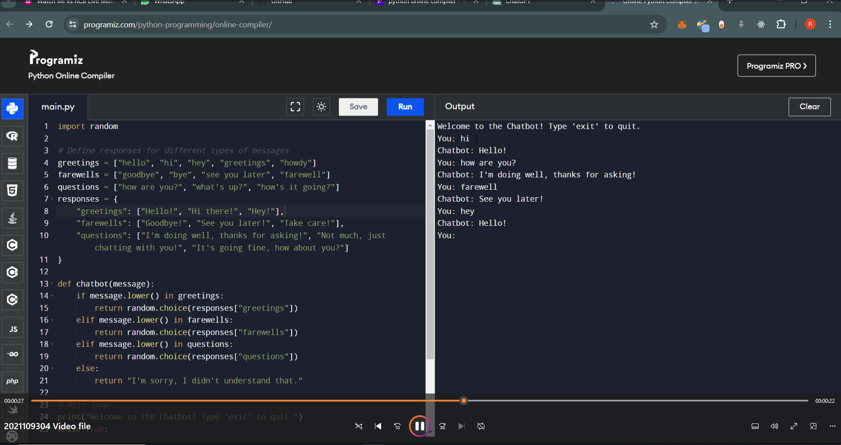
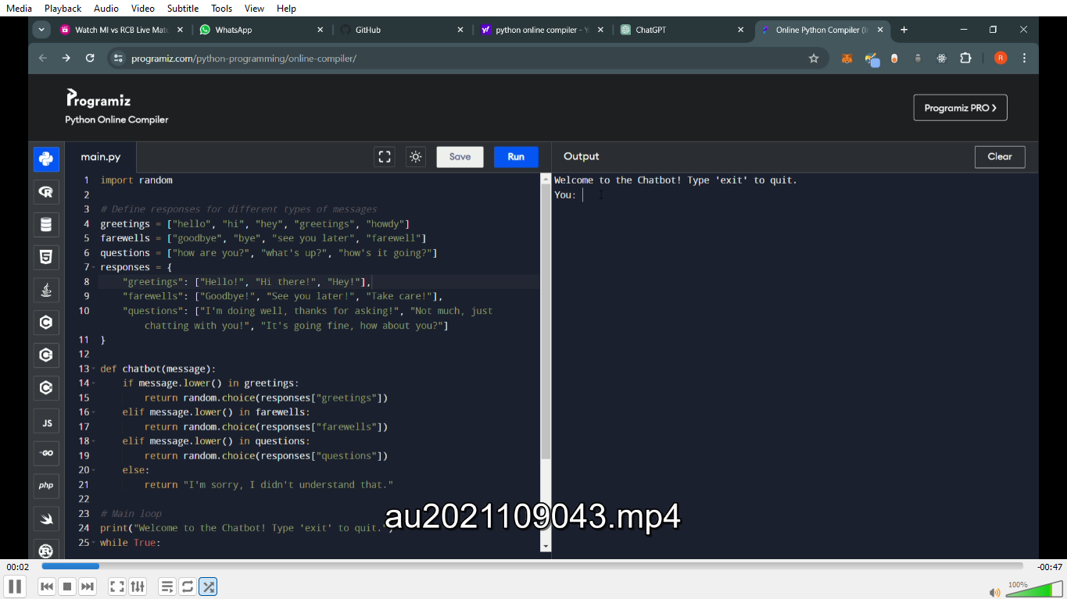
Project Demo(Recorded Video)

Slide 8
Conclusion
SUCCESSFULLY,THE PROJECT WAS DONE...

Slide 9
Future Scope
CUSTOMER QUERY AUTOMATION
EDUCATIONAL PURPOSE

Slide 10
References
https://github.com/LATHIKA2/LATHIKA-NM-SPACE.git

Slide 11
THANK YOU

